Slide 1
Chapter-III Basic Organic Chemicals/Products
Chemicals are part of our everyday lives.
The hundreds of chemicals that are manufactured by industrial processes influence what we do and how we do it.
This chapter offers descriptions and process details of the most popular of those chemicals.
The manufacture of chemicals involves many facets (subjects) of chemistry and chemical engineering which are completely treated to descriptions of the most important chemical conversions and processes of industrial operations.
This chapter will, therefore, emphasize the simple principles of systems of chemical manufacture rather than complex processes details that are often difficult to understand.

Slide 2
3.1. Introduction to Industrial organic synthesis
Where do industrial organic chemicals come from???
Natural gas and petroleum are the main sources. From them come seven chemical
building blocks on which a vast organic chemical industry is formed/based.
These are ethylene, propylene, the C4 olefins (butenes and butadiene), benzene, toluene, xylenes (ortho, meta,and para), and methane.
The olefins—ethylene, propylene and butadiene, and the butenes—are derived from both natural gas and petroleum.

Slide 3
3.2 Manufacture of Alcohols A. Methanol
The synthesis gas thus produced is cooled to ambient temperature, and heat is recovered to generate the high-pressure steam required for the processing of hydrocarbon feedstock.
Methanol is produced in a methyl converter in presence of Cu-Zn-Cr catalyst at 50 -100 bar (49–99 atm) pressure and 250-260ºC temperature according to the following reaction.
The stoichiometric ratio of hydrogen to carbon in the synthesis gas is adjusted to 2:1.

Slide 4
The yield of methanol obtained is 61%.
The equipment for this process includes a reactor, separator and three distillation columns.
The flow diagram representing this process and the chemical reaction processes are shown below.

Slide 5
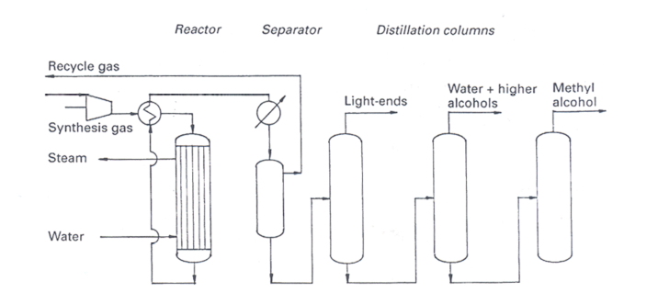
cont’d
Fig 1. Methanol Production from Synthesis Gas.

Slide 6
B. Manufacture of Ethanol
The first commercial process used for ethyl alcohol production was the indirect catalytic hydration of ethylene.
It had several disadvantages such as handling large volumes of dilute sulfuric acid, energy required for its concentration, and corrosion caused by the acid.
The current industrial processes for the manufacture of ethyl alcohol are direct catalytic hydration of ethylene and carbonylation of methyl alcohol.
Brief description of these two conventional processes is presented below.

Slide 7
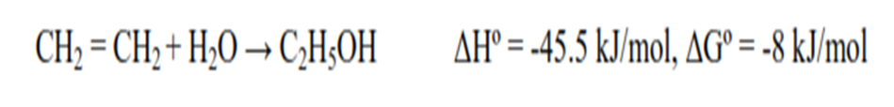
In the direct hydration of ethylene:
the reaction is conducted in a reactor containing a fixed-bed catalyst consisting of 77% phosphoric acid absorbed onto a carrier such as silica gel.
The operating temperature and pressure are in the range of 230-300°C and 60-80 bar (60-80 atm) respectively.
Ethyl alcohol is produced according to the following reaction..

Slide 8
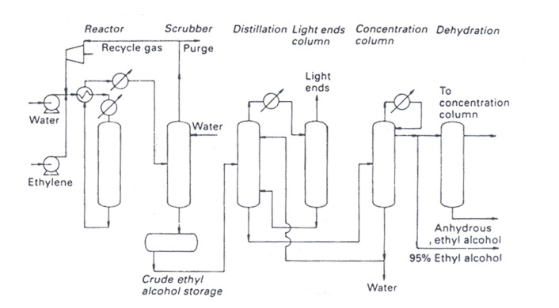
The conversion of ethylene to ethanol gives a net yield of 97% .
The reaction is exothermic, and the excess heat is used to raise the temperature of the incoming feed .
The flow sheet representing this process is shown in Fig 2.
Fig 2.. Ethanol Production from Direct Hydration of Ethylene.

Slide 9

C. Manufacture of Isopropanol
Historically, there has been a shortfall of acetone, and it would have been uneconomic to satisfy acetone demand by the accumulation of unsaleable phenol
Hence an alternative route to acetone was required. The alternative route already existed. It was the ﬁrst petrochemical reaction.
Absorption of propylene in concentrated sulfuric acid gave isopropyl sulfate, which was hydrolyzed to isopropanol.
This had a number of uses, primarily as a solvent, but some of it was air-oxidized or dehydrogenated to acetone.

Slide 10
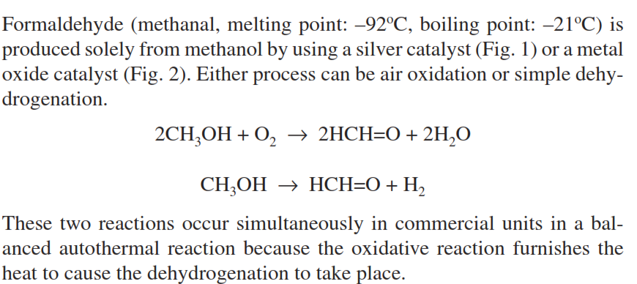
3.2. Manufacture of Formaldehyde
3
4

Slide 11
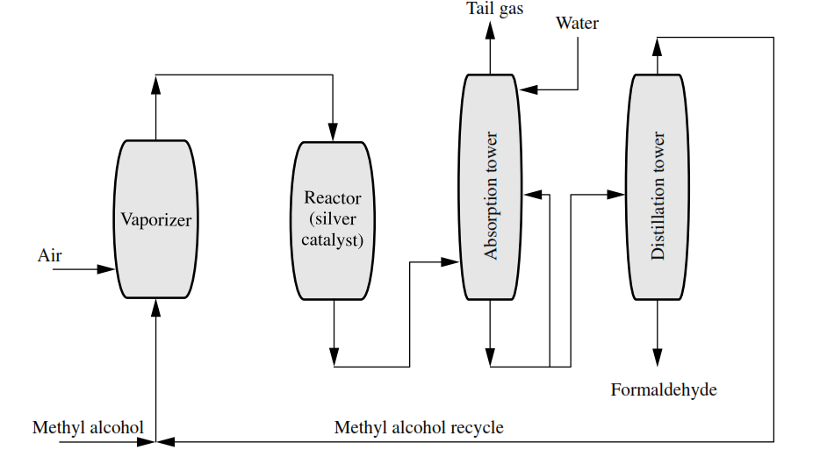
cont’d
Fig.3 Formaldehyde manufacture using a silver catalyst.

Slide 12
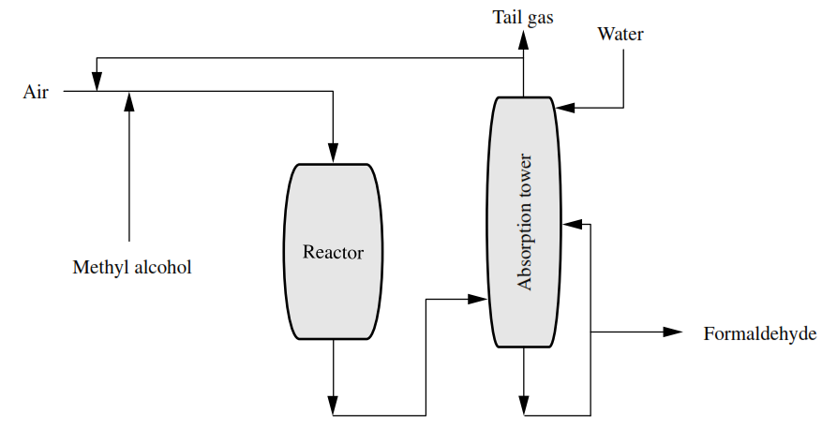
Cont’d
Fig. 4 Formaldehyde manufacture using a metal oxide catalyst.

Slide 13
3.4.Manufacture of Acetic acid and Acetaldehyde
Acetic acid (ethanoic acid, vinegar acid, CH3CO2H, melting point 16.6o C, boiling point: 117.9o C, density: 1.0490, flash point: 43o C, ignition temperature 465o C) is a colorless, pungent liquid that is miscible with water, alcohol, and ether in all proportions.
Acetic acid is available commercially in several concentrations:
(1) glacial acetic is approximately 99.7% glacial acetic acid with water the principal impurity,
(2) reagent grade acetic acid generally contains 36% acetic acid by weight

Slide 14
(3) commercial aqueous solutions are usually 28, 56, 70, 80, 85, and 90% acetic acid.
Acetic acid is the active ingredient in vinegar, in which the content ranges from 4 to 5% acetic acid.
Acetic acid is classified as a weak, monobasic acid (-CO2H) but the three hydrogen atoms linked to the carbon atom (CH3) are not replaceable by metals.

Slide 15
Acetic acid is manufactured by three processes: acetaldehyde oxidation, n-butane oxidation, and methanol carbonylation.
Ethylene is the exclusive organic raw material for making acetaldehyde, 70 percent of which is further oxidized to acetic acid or acetic anhydride.
The single-stage (Wacker) process for making acetaldehyde involves cupric chloride and a small amount of palladium chloride in aqueous solution as a catalyst.
CH2=CH2 + H2O + PdCl2 → CH3CHO + 2HCl + Pd
The yield is 95 percent and further oxidation of the acetaldehyde produces acetic acid (Fig. 5).
2CH3CHO + O2 → 2CH3CO2H

Slide 16
A manganese or cobalt acetate catalyst is used with air as the oxidizing agent in the temperature and pressure ranges of 55 to 80 oC and 15 to 75 psi;
the yield is 95 %.
The second manufacturing method for acetic acid utilizes butane from the C4 petroleum stream rather than ethylene.
A variety of products is formed but conditions can be controlled to allow a large percentage of acetic acid to be formed.
Cobalt, manganese, or chromium acetates are catalysts with temperatures of 50 to –250 oC and a pressure of 800 psi.

Slide 17
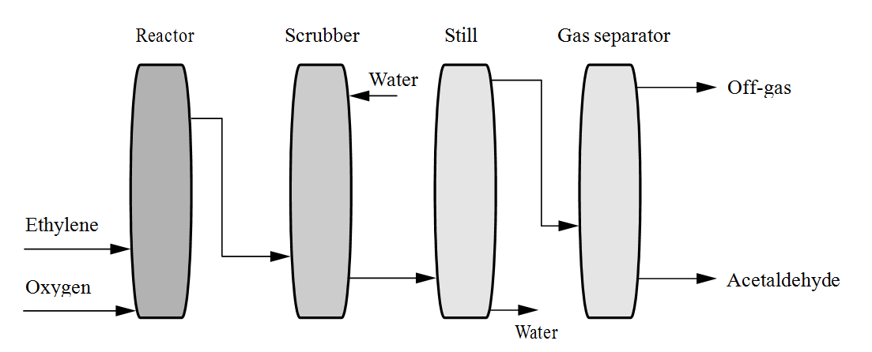
cont’d
Fig.5 Acetaldehyde manufacture by the single-stage (Wacker) process.

Slide 18
C4H10 + O2 → CH3CO2H + HCO2H + CH3CH2OH + CH3OH.
The third and preferred method of acetic acid manufacture is the carbonylation of methanol, involving reaction of methanol and carbon monoxide (both derived from methane) with rhodium and iodine as catalysts at 175 oC and 1 atm (Fig. 6).Light ends, catalyst recovery, dehydrator.
CH3OH + CO → CH3CO2H
The yield of acetic acid is 99 percent based on methanol and 90 percent based on carbon monoxide.
Acetic acid is used for the manufacture of methyl acetate and acetic anhydride, vinyl acetate, ethyl acetate, terephthalic acid, cel- lulose acetate, and a variety of acetic esters.

Slide 19
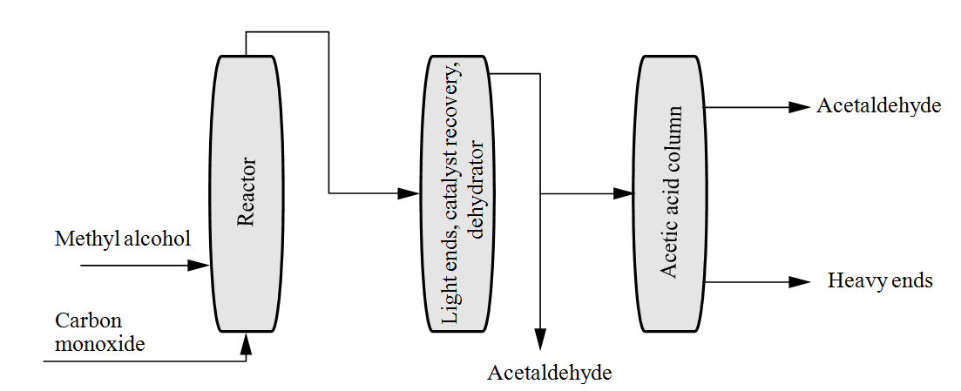
Cont’d
Fig. 6 Acetaldehyde manufacture by carbonylation of methyl alcohol (methanol).

Slide 20
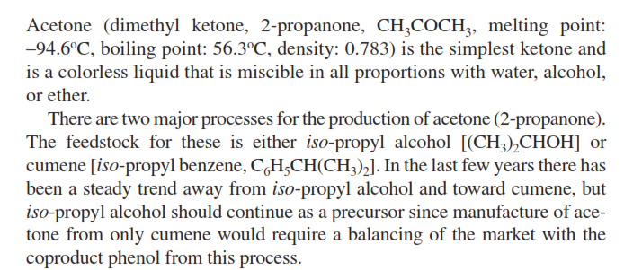
3.5 Manufacture of Acetone

Slide 21
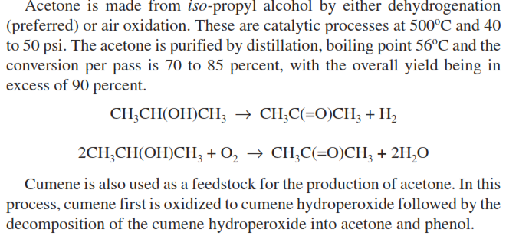
Cumene is isopropylbenzene

Slide 22
3.6 Manufacture of Phenol
Phenol (hydroxybenzene; freezing point: 40.9 oC, boiling point: 181.8 oC, density: 1.0722; flash point: 79 oC) at room temperature is a white, crystalline mass.
Phenol gradually turns pink if it contains impurities or is exposed to heat or light. It has a distinctive sweet, tarry odor, and burning taste.
Phenol has limited solubility in water between 0 and 65 oC Above 65.3 oC, phenol and water are miscible in all proportions.

Slide 23
Phenol is very soluble in alcohol, benzene, chloroform, ether, and partially disassociated organics in general, but it is less soluble in paraffinic hydrocarbons.
Phenol has been made, over the years, by a variety of processes.
Historically, an important method was the suffocation of benzene followed by desulfonation with caustic soda:
C6H6 + H2SO4 → C6H5SO3H + H2O
C6H5SO3H + 2NaOH → C6H5OH + Na2SO4

Slide 24
This route to phenol is no longer used.
The principal process in use is the peroxidation of cumene (iso-propyl benzene) at 130oC in the presence of air and a catalyst followed by decomposition of the peroxide at 55 to 65oC in the presence of sulfuric acid.
C6H5CH(CH3)2 → C6H5C(CH3)2OOH
C6H5C(CH3)2OOH → C6H5OH + CH3COCH3
In the cumene process (Fig. 7), cumene is oxidized to form cumene hydroperoxide that is then concentrated and cleaved to produce phenol and acetone.

Slide 25
By-products of the oxidation reaction are acetophenone and dimethyl benzyl alcohol, which is dehydrated in the cleavage reaction to produce alpha -methylstyrene.
The toluene-benzoic acid process involves three chemical reactions:
(1) oxidation of toluene to form benzoic acid,
2C6H5CH3 + 3O2 → 2C6H5CO2H + 2H2O
(2) oxidation of benzoic acid to form phenyl benzoate, and
4C6H5CO2H + O2 → 2C6H5CO2C6H5 + 2H2O + 2CO2

Slide 26
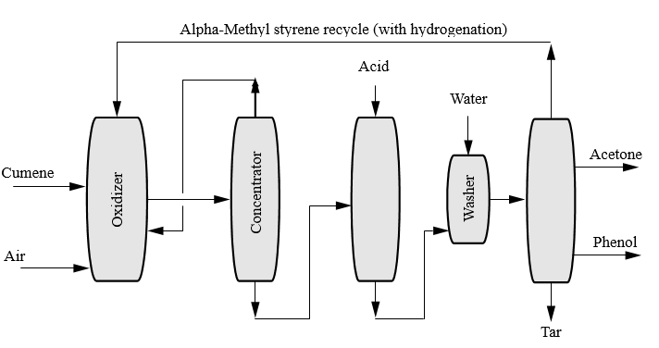
Cont’d
Fig.7 Manufacture of phenol from cumene.

Slide 27
(3) hydrolysis of phenyl benzoate to form phenol.
C6H5CO2C6H5 + 2OH- → 2C6H5OH + CO2A
Typical process (Fig. 8) consists of two continuous steps.
In the first step: the oxidation of toluene to benzoic acid is achieved with air and cobalt salt catalyst at a temperature between 121 and 177oC (206 kPa gauge), and the catalyst concentration is between 0.1 and 0.3%.
The reactor effluent is dis- tilled, and the purified benzoic acid is collected.

Slide 28
In the second processing step, the benzoic acid is oxidized to phenyl benzoate in the presence of air and a catalyst mixture of copper and magnesium salts (234oC, 147 kPa gauge).
The phenyl benzoate is then hydrolyzed with steam in the second reactor to yield phenol and carbon dioxide (200oC and atmospheric pressure).

Slide 29
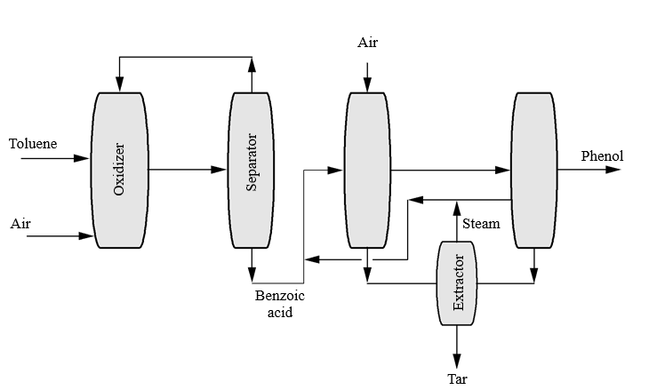
cont’d
Fig. 8 Manufacture of phenol from toluene

Slide 30
The production of phenol from cyclohexene
Phenol is produced from cyclohexene (benzene is partially hydrogenated to cyclohexene in the presence of water and a ruthenium-containing catalyst).
The cyclohexene is then reacted with water to form cyclohexanol or oxygen to form cyclohexanone, and the cyclohexanol or cyclohexanone is dehydrogenated to phenol.

Slide 31
The production of phenol from benzene
In the benzene sulfonation process, benzene reacts with concentrated sulfuric acid to form benzenesulfonic acid at about 150oC.
C6H6 + H2SO4 → C6H5SO3H + H2O
C6H5SO3H + 2NaOH → C6H5OH + Na2SO4
The benzenesulfonic acid is neutralized with sodium sulfate to produce sodium benzenesulfonate, which is then fused with caustic soda to yield sodium phenate, which, after acidification with sulfur dioxide and a small amount of sulfuric acid, releases phenol from the sodium salt.

Slide 32
In the chlorobenzene process, benzene is chlorinated at 38 to 60oC in the presence of ferric chloride (FeCl3) catalyst. The chlorobenzene is hydrolyzed with caustic soda at 400oC and 11,000 psi (2.56 kPa) to form sodium phenate. The impure sodium phenate reacts with hydrochloric acid to release the phenol from the sodium salt.
In the benzene oxychlorination process, also known as the Raschig process, benzene is oxychlorinated with hydrogen chloride and air in the presence of iron and copper chloride catalyst to form chlorobenzene.

Slide 33
The reaction occurs at 200 to 260oC and atmospheric pressure.
The chlorobenzene is hydrolyzed at 480oC in the presence of a suitable catalyst to pro- duce phenol and chloride.
Phenol is used in the manufacture of formaldehyde resins, bisphenol A, caprolactam, aniline, xylenols, and alkylphenols.
Phenol-formaldehyde polymers (phenolic resins) have a primary use as the adhesive in plywood formulations.
The use of phenol in detergent synthesis to make alkylphenols is an important aspect of phenol utility.

Slide 34

Manufacture of Styrene
Dehydrogenation is a reaction that results in the removal of hydrogen from an organic compound or compounds, as in the dehydrogenation of ethane to ethylene:
This process is brought about in several ways. The most common method is to heat hydrocarbons to high temperature, as in thermal cracking, that causes some dehydrogenation, indicated by the presence of unsaturated compounds and free hydrogen.

Slide 35
In the chemical process industries, nickel, cobalt, platinum, palladium, and mixtures containing potassium, chromium, copper, aluminum, and other metals are used in very large-scale dehydrogenation processes.
Styrene is produced from ethylbenzene by dehydrogenation.
Many lower molecular weight aliphatic ketones are made by dehydration of alcohols.

Slide 36
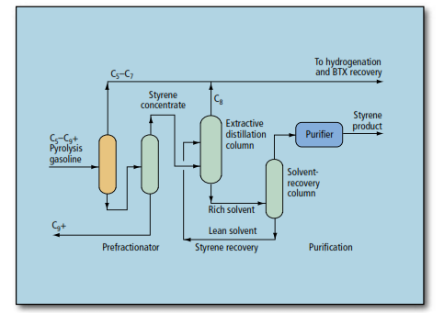
Cont’d
Fig.9 Manufacture of styrene from gasoline

Slide 37
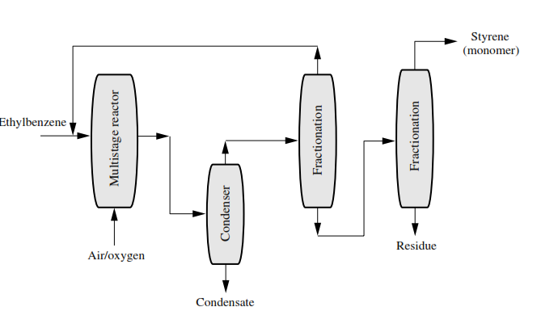
cont’d
Fig.10 Styrene Manufacturing from ethyl benzene

